Slide 1
10.1 Submarine History
CSS Hunley
Turtle: Revolutionary War; Hunley: Civil War (both human powered)
Holland:1900 (gasoline/electric powered)
WWI & WWII: German & U.S. submarines prove highly effective
Combination of USS Albacore (teardrop) hull shape and nuclear propulsion = modern submarines
Navy mostly uses submarines (indefinite underwater endurance)
Commercial industry uses submersibles (limited endurance)
Expensive but stealthy!
Share characteristics of both surface ships and aircraft

Slide 2
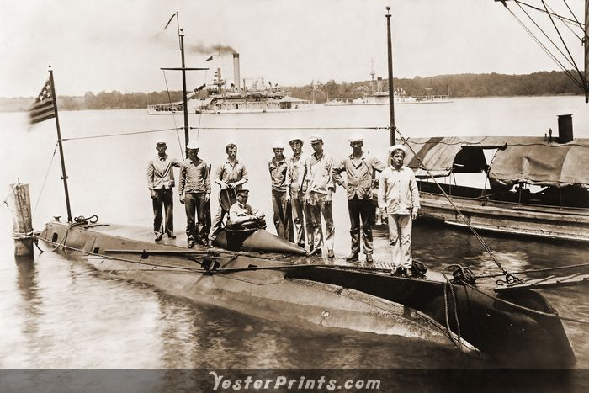
USS HOLLAND

Slide 3
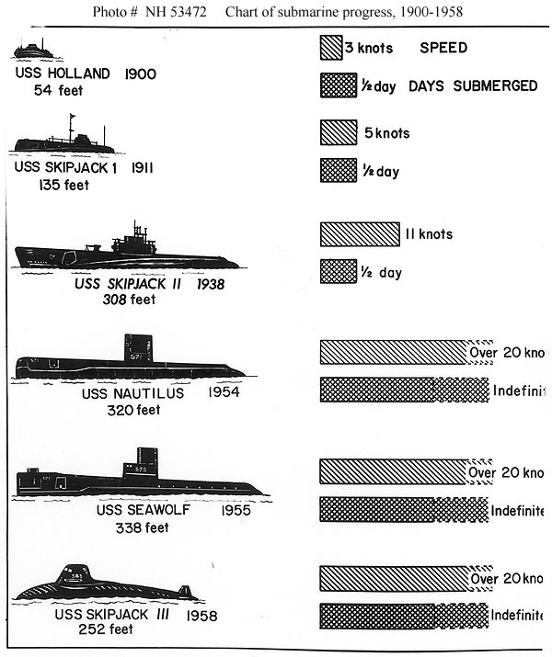
Submarine
Progress
1900-1958

Slide 4
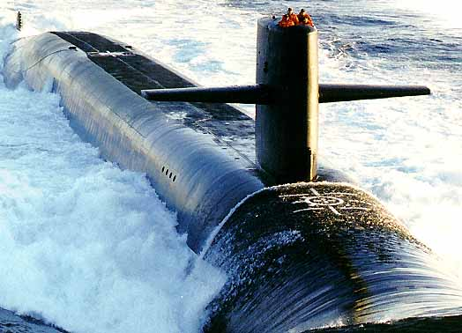
U.S. Submarine Types
OHIO Class
14 SSBNs
4 SSGNs

Slide 5
U.S. Submarine Types
Ohio Class
  Sub Launched Ballistic Missiles (SLBMs) aft of sail
  Δ greater than many surface ships (i.e. BIG)

Slide 6
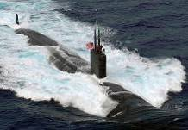
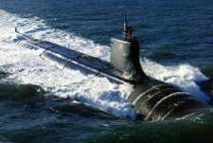
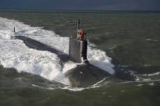
Attack Submarine Classes
LOS ANGELES Class
Backbone of the U.S. Submarine Force
44 ships currently in service
SEAWOLF Class
3 Ship Class
USS JIMMY CARTER (SSN 23) reconfigured to include multi-mission platform
VIRGINIA Class
First submarine designed for the post-Cold War security environment
5 ships commissioned
7 under construction; 6 under contract
Notes:
6

Slide 7
U.S. Submarine Types
Los Angeles Class (SSN688)

Slide 8
U.S. Submarine Types

Slide 9
U.S. Submarine Types

Slide 10
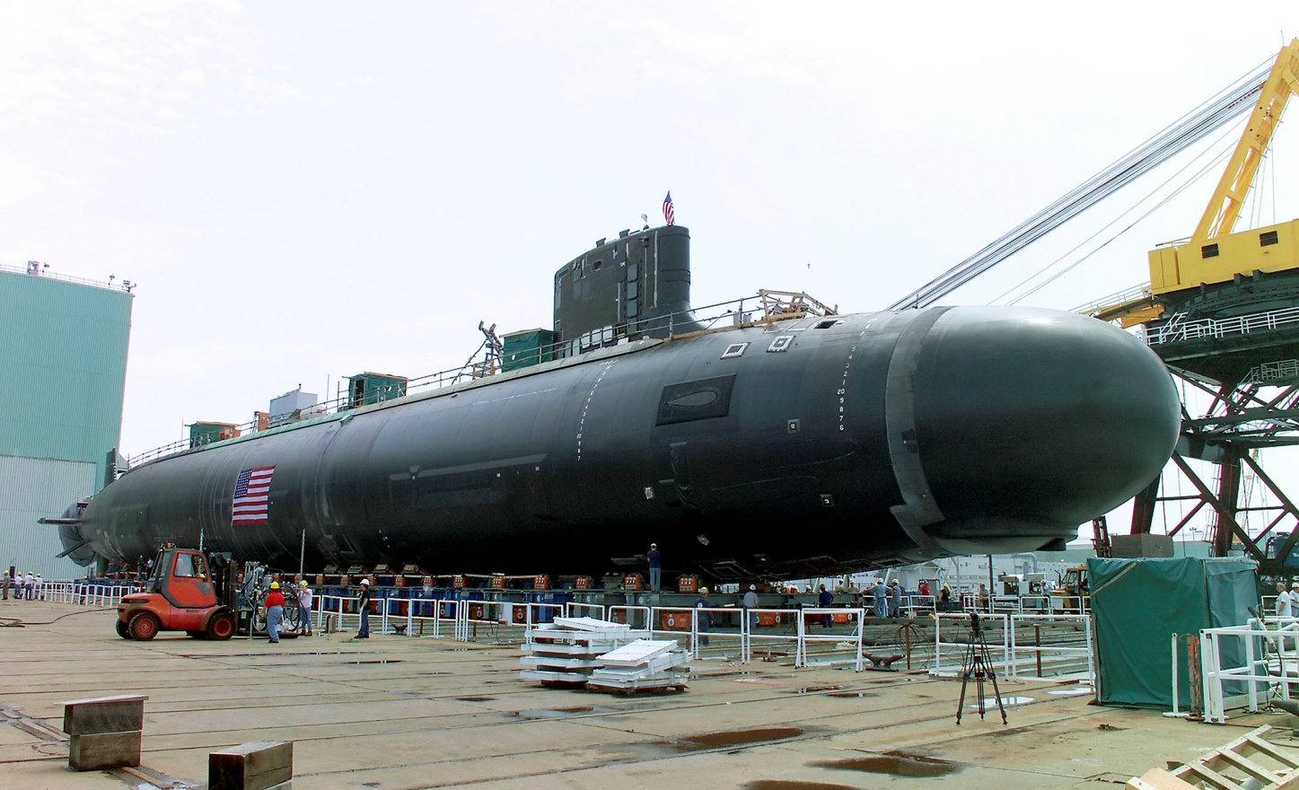
U.S. Submarine Types
Virginia Class
Displacement: 7,800 tons
Length: 377 feet
Draft: 32 feet
Beam: 34 feet
Depth: 800+ feet

Slide 11
U.S. Submarine Types
USS Dolphin
AGSS-555
NR1
L = 165 feet
Diesel/Electric
3000 feet depth!
L = 145 feet
Nuclear
2400 feet depth
Notes:
DOLPHIN: decommed in 2007
NR1: out of service 2008

Slide 12
10.2 Submarine Construction & Layout
Hydrostatic pressure is the biggest concern
  Transverse frames dominate “skeleton”
  P_{abs}=P_{atm}+ρgz (P_{gage}=ρgz)
  Pressure rises ~3atm or ~44psi per 100ft
  Only pressure hull (“People Tank”) has to support this pressure difference. (MBTs & superstructure do not)
  Hull circularity is required to avoid stress concentration and hull failure.
  Only Electric Boat (Groton, CT) and Newport News (VA) are certified to build modern US Navy nuclear submarines.

Slide 13
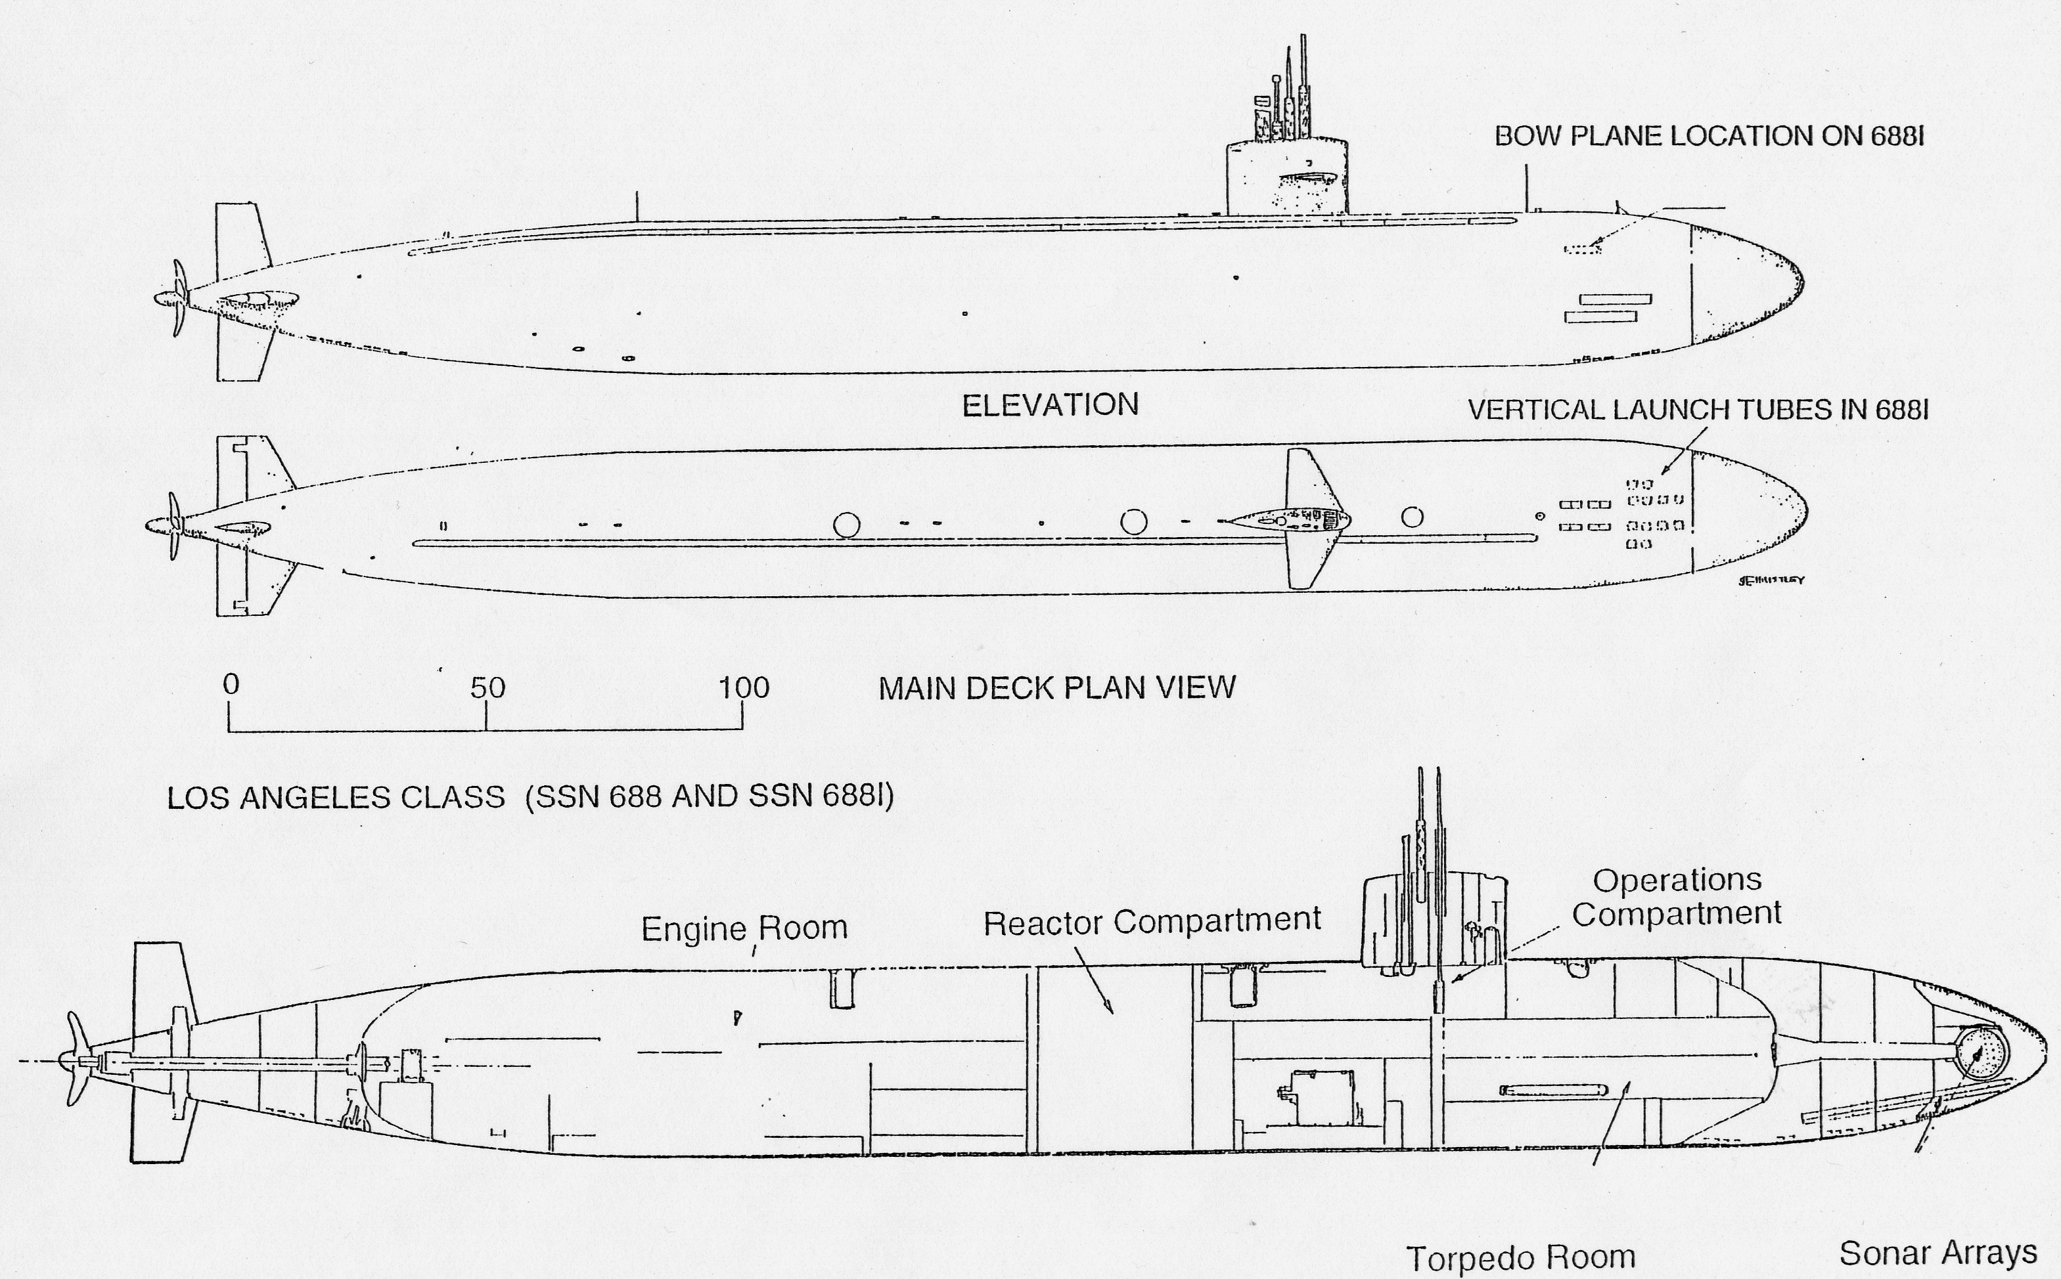

Slide 14
Submarine Inner Hull
Holds the pressure sensitive equipment (including the
crew!)
Must withstand hydrostatic pressure at ops depth
Transversely framed with thick plating
Strength ⇑ = $ ⇑, Δ ⇑, space ⇓ , but depth ⇑
Advanced materials needed due to high σ

Slide 15
Submarine Outer Hull
Smooth fairing over non-pressure sensitive
equipment such as ballast and trim tanks and
anchors to improve vessel hydrodynamics.
High strength not required so made of mild steels and fiberglass.
Anechoic (“free from echoes and reverberation”)
material on outer hull to decrease sonar signature.

Slide 16
Submarine General Arrangements
Main Ballast Tanks
Variable Ballast Tanks
PRESSURE HULL

Slide 17
Main Ballast Tanks (MBT)
Largest tanks
Alter Δ from positive buoyancy on surface (empty) to near neutral buoyancy when submerged (full)
Main Ballast Tanks are “soft tanks” because they
do not need to withstand submerged hydrostatic pressure (located between inner & outer hulls)

Slide 18
Variable Ballast Tanks
Depth Control Tank (DCT)
  Alter buoyancy once submerged.
  Compensates for environmental factors (water density changes).
  ‘Hard tank’ because it can be pressurized (has access to outside of pressure hull).
Trim Tanks (FTT/ATT)
  ‘Soft tanks’ shift water to control trim (internal)

Slide 19
10.3 Submarine Hydrostatics
To maintain depth control, the goal is “Neutral Buoyancy”. Impacted by anything which changes the weight/volume (density) of water or submarine:
  Salinity
  Temperature
  Pressure/depth
  Use Δ=F_{B}=ρgV to calculate changes

Slide 20
Hull Form Characteristics
Surfaced:
  Similar to Surface Ship, KM_{L}>>KM_{T}
  G is BELOW B and M_{T}
Submerged:
  B=M_{T}
Transition:
  Free Surfaces in MBTs
  raise G_{eff}, temporarily
  degrading stability
Surfaced Submarine
Surface Ship
M_{T}
G
Submerged
Submarine
M_{T}
B
B
K
G
K
B
M_{T}
G
K

Slide 21
Submarine Hydrostatics
Static equilibrium and Archimedes Principle apply to subs as well
Unlike surface ships, subs must actively pursue equilibrium when submerged due to changes in density (ρ) and volume (∇)
Depth Control Tanks & trim tanks are used

Slide 22
Hydrostatic Challenges
MAINTAIN NEUTRAL BUOYANCY
  Salinity Effects
  Water Temperature Effects
  Depth Effects
MAINTAIN NEUTRAL TRIM AND LIST
  Transverse Weight Shifts
  Longitudinal Weight Shifts

Slide 23
Hydrostatics (Salinity Effects)
Water density (ρ) ↓ as salinity level ↓
Decreased ρ = less F_{B}
∆ > F_{B}
Must pump water out of DCT
Changes in salinity common near river estuaries or polar ice

Slide 24
Hydrostatics (Temperature Effects)
Water density (ρ) ↓ as temperature ↑
Decreased ρ = less F_{B}
∆ > F_{B}
Must pump water out of DCT to compensate
Changes in temperature near river estuaries or ocean currents

Slide 25
Hydrostatics (Depth Effects)
As depth increases, sub is “squeezed” and volume (∇) decreases
Decreased ∇ = less F_{B}
∆ > F_{B}
Must pump water out of DCT
Anechoic tiles cause additional volume loss as they compress more

Slide 26
Weight Shifts
Transverse Weight Shift:
tan(Φ)=opp/adj=G₀G_{f}/G₀B;
G₀G_{f}=(w/Δ)g₀g_{f};
g₀g_{f}= t;
G₀G_{f}=(w/Δ)t;
tan(Φ) = wt/(ΔG₀B)=wt/(ΔBG₀)
Longitudinal Weight Shift:
tan(θ)=opp/adj=G₀G_{f}/G₀B;
G₀G_{f}=(w/Δ)g₀g_{f};
g₀g_{f}= l;
G₀G_{f}=(w/Δ)l;
tan(θ) = wl/(ΔG₀B)=wl/(ΔBG₀)
ϑ
g₀
g₀
l
F_{B}
t
B
g_{f}
G₀
G_{f}
F_{B}
g_{f}
Δ
B
Φ
B
G₀
ϑ
G_{f}
G₀
Δ
G_{f}

Slide 27
Transverse Weight Shifts
In Submarine Analysis:
  Calculation of heeling angle simplified by identical location of Center of Buoyancy (B) and Metacenter (M).
  Analysis involves the triangle G₀G_{T}B and a knowledge of the weight shift.
  This equation is good for all angles:
Δ
Δ
BG
=
BG
Tan
Φ
wt
S
0

Slide 28
Trim Weight Shifts
Sub longitudinal analysis is exactly the same as transverse case. For all angles of trim:
Moment arm l > > t, so trim tanks to compensate
Δ
BG
Tan
=
wl
S
θ
0

Slide 29
Example Problem
Two 688 Class submarines are transiting from the Pacific Ocean (ρ=1.99lb-s²/ft⁴) up Puget Sound (ρ=1.965lb-s²/ft⁴), one surfaced at a draft of 27ft with an A_{wp} of 6600ft² and Δ=6000LT and the other submerged with Δ=6900LT.
What is the final draft in feet and inches of the surfaced submarine?
What must the submerged submarine do to maintain neutral buoyancy?

Slide 30
Example Answer
Δ=F_{B}=ρgV
What changes? What remains the same?
  Surfaced:
    ρ changes,
    F_{B}=Δ stays same,
    so V changes
  Submerged
    ρ changes,
    V stays same,
    so F_{B} changes

Slide 31
Example Answer
Both are Archimedes/Static Equilibrium Problems
  Surfaced:
    Downward force=Δ=6000LT=F_{B}
    V_{ocean water}=Δ/(ρg)=6000LT×2240lb/LT/
    (1.99lb-s²/ft⁴×32.17ft/s²)=209,940ft³
    V_{Puget Sound water}=Δ/(ρg)=6000LT×2240lb/LT/ (1.965lb-s²/ft⁴×32.17ft/s²)=212,610ft³
    Difference=212,610ft³-209,940ft³=2670ft³
    Change in draft=V_{Difference}/A_{wp}=2670ft³/6600ft²
    =0.405ft×12in/ft=4.86in
    Final Draft=27ft 4.86in (deeper because larger volume of Puget Sound water required to generate the same buoyant force)

Slide 32
Example Answer
Both are Archimedes/Static Equilibrium Problems
  Submerged:
    Downward force=Δ=6900LT
    Initial Buoyant Force=Δ=6900LT=ρ_{ocean}g∇_{sub}
    ∇_{sub}=Δ/ρ_{ocean}g
    Final Buoyant Force=ρ_{Puget Sound}g∇_{sub}=
    ρ_{Puget Sound}g×(Δ/ρ_{ocean}g)=Δ×ρ_{Puget Sound}/ρ_{ocean} =
    6900LT×1.965/1.99=6813LT
    Difference=6900LT-6813LT=87LT downward
    Sub must pump off 87LT of ballast

Slide 33
10.4 Submarine Intact Stability
- Initial stability simplified for subs
- The distance BG is constant (=GM)
- Righting Arm (GZ) is purely a function of heel angle
  EQUATION IS TRUE FOR ALL SUBMERGED SUBS IN ALL CONDITIONS!
- Since B does not move submerged, G must be below B to maintain positive stability
Righting
Arm
=
GZ
=
BG
Sin
Φ

Slide 34
Submarine Intact Stability
Since righting arm equation good for all φ, curve of intact statical stability always a sine curve with a peak value equal to BG.

Slide 35
Submerged Stability Characteristics
        Range of Stability: 0-180°
        Angle of Max Righting Arm: 90°
        Max Righting Arm: Distance BG
        Dynamic Stability: 2Δ_{S}BG
STABILITY CURVE HAS THE SAME CHARACTERISTICS FOR ALL SUBS!

Slide 36
10.5 Submarine Resistance
R_{T}=R_{V}+R_{W}+R_{AA}
  R_{T}=Total Hull Resistance
  R_{V}=Viscous Resistance
  R_{W}=Wavemaking Resistance
  R_{AA}=Calm Air Resistance
C_{T}=C_{V}+C_{W}
  C_{T}=Coefficient of Total Hull Resistance
  C_{V}=Coefficient of Viscous Resistance
  C_{W}=Coefficient of Wavemaking Resistance
C_{V}=(1+K)C_{F}
  C_{F}=Tangential (Skin Friction) component of viscous resistance
  K=Correction for normal (Viscous Pressure Drag) component of viscous resistance

Slide 37
Submarine Resistance
On surface (acts like a surface ship):
  C_{V} dominates at low speed, C_{W} as speed increases (due to bigger bow and stern waves and wake turbulence).
Submerged (acts like an aircraft):
  Skin friction (C_{F} ∴ C_{V}) dominates.
    (Rn is more important when no fluid (air/water) interface)
  C_{W} tends toward zero at depth.
  Since C_{T} is smaller when submerged, higher speeds are possible

Slide 38
Submarine Propellers
Odd blade number
Skewed propeller
  Reduced vibration
  Reduced cavitation
  Disadvantages:
    Poor in backing
    Difficult/expensive to manufacture
    Reduced strength
Operational need outweighs disadvantages!

Slide 39
Submarine Propellers

Slide 40
10.6 Submarine Seakeeping
Subjected to same forces and moments as surface ships:
  3 translation (surge, sway, heave)
  3 rotational (roll, pitch,yaw)
  Recall heave, pitch, and roll are simple harmonic motions because of linear restoring force
If ω_{e} = resonant freq, amplitudes maximized (particularly roll which
is sharply tuned).
Surface wave action diminishes exponentially with increasing depth

Slide 41
Submarine Seakeeping
Periscope Depth
  Suction Forces
    Water Surface Effect
      Bernoulli effect similar
      to shallow water “squat”
      Control speed, depth, angle,
      & extra weight carried
    Wave Action
      Bernoulli effect due to waves
      Control speed, depth, angle, course,
      & extra weight carried
Higher relative
speed water, hence
lower pressure
Direction
of Seas
If Diving Officer is about
to broach, use rudder to:
- slow sub
- turn away from waves
to reduce wave
action along deck
- (increases roll motion)

Slide 42
10.7 Submarine Maneuvering and Control
Achieve Neutral Buoyancy Hydrostatically
Drive the Boat Hydrodynamically
Lateral motion controlled with rudder, engines, and propellers
Depth control accomplished by:
  Making the buoyant force equal the submarine displacement as in previous section
  Finer and more positive control achieved by planes, angle, and speed

Slide 43
Submarine Maneuvering and Control
Fairwater Planes
  Lift & some angle
  Mainly depth control
Bow Planes
  When no Fairwater Planes only
  Mostly angle
Stern Planes
  Angle
Hull
  With positive angle of attack, hull provides lift and sub “swims” toward ordered depth
Increasing speed increases effectiveness of planes and ship’s angle (F ∝ ½ρAV²)
Remember: Planes, Angle, Speed (similar for aircraft)
Lift & Moment
due to Fairwater
Planes
G
Moment due to Stern Planes
Moment due to Bow Planes

Slide 44
Submarine Maneuvering and Control
Snap Roll
  Loss of depth control on high speed turn
Water force on Sail
as sub “slides” around turn
Rudder force has a downward vertical
component as sub heels in turn

Slide 45
Example Problem
A submerged submarine’s G moves down. What happens to:
  Range of Stability: Increases Decreases Stays Same
  Dynamic Stability: Increases Decreases Stays Same
  Angle of Max GZ: Increases Decreases Stays Same
  Max GZ: Increases Decreases Stays Same
A given submarine maintains the same throttle settings while surfaced and then submerged. Under which condition is it going faster and why?

Slide 46
Example Answer
A submerged submarine’s G moves down. What happens to:
  Range of Stability: Increases Decreases Stays Same
  Dynamic Stability: Increases Decreases Stays Same
  Angle of Max GZ: Increases Decreases Stays Same
  Max GZ: Increases Decreases Stays Same
A given submarine maintains the same throttle settings while surfaced and then submerged. Under which condition is it going faster and why?
  It is going faster submerged because it no longer “wastes” as much energy generating a wave on the surface of the water. It has decreased wave making resistance.

Slide 47
Backup Slides

Slide 48
Submarine Structural Design
Longitudinal Bending
  Hogging & sagging causes large compressive and tensile stresses away from neutral axis.
  A cylinder is a poor bending element
Hydrostatic Pressure = Major load for subs
  Water pressure attempts to implode ship
  Transverse frames required to combat loading
  A cylinder is a good pressure vessel!

Slide 49
Neutral Trim
Surfaced submarine similar to surface ship except G is below B
  For clarity, M_{T} is shown above B although distance is very small in reality.
Neutral trim on sub becomes extremely critical when submerged

Slide 50
Neutral Trim
When submerging, waterplane disappears, so no second moment of area (I), and therefore no metacentric radius (BM_{L} or BM_{T})
“B”, “M_{T}” and “M_{L}” are coincident and located at the centroid of the underwater volume, the half diameter point (if a cylinder)
Very sensitive to trim since longitudinal and transverse initial stability are the same

Slide 51
Neutral Trim
When completely submerged, the positions of B, M_{T} and M_{L} are in the same place

Slide 52
10.4 Submarine Intact Stability
Righting Arm (GZ) = BGsin(φ)
Since B does not move submerged,
G must be below B to maintain
positive stability
GZ
BG
F_{B}
Φ
φ
B
0°
90°
180°
Range of Stability=0-180°
Angle of RA_{max}=90°
GZ_{max}=BG
Dynamic Stability=ΔBG∫sin(φ)dφ
=2ΔBG
G
Z
Δ

Slide 53
Submarine Submerged Intact Stability

Slide 54
Submarine Maneuvering and Control
X-Diherals
  All planes move on any turn or depth change
  Complex control system – poor casualty control
Stern Planes on Rise
Left Rudder

Slide 55
Fair-Water Planes
Primarily to maintain an ordered depth.
  Positioning the planes to the "up" position causes an upward lift force to be generated
  Since forward of the center of gravity, a moment (M) is also produced which causes some slight pitch
The dominant effect is the lift generated by the control
surface

Slide 56
Fair-Water Planes
Primarily DEPTH CONTROL

Slide 57
Stern and Bow Planes
Primarily to maintain pitch because of the distance from the
center of gravity
  Positioning the planes to creates a lift force in the downward direction creates a moment (M) which causes the submarine to pitch up
  Once the submarine has an up angle, the hull produces an upward lift force
Net effect is that the submarine rises at an upward angle

Slide 58
Stern and Bow Planes
Maintain Pitch
(better control than with fairwater planes)

